Slide 1
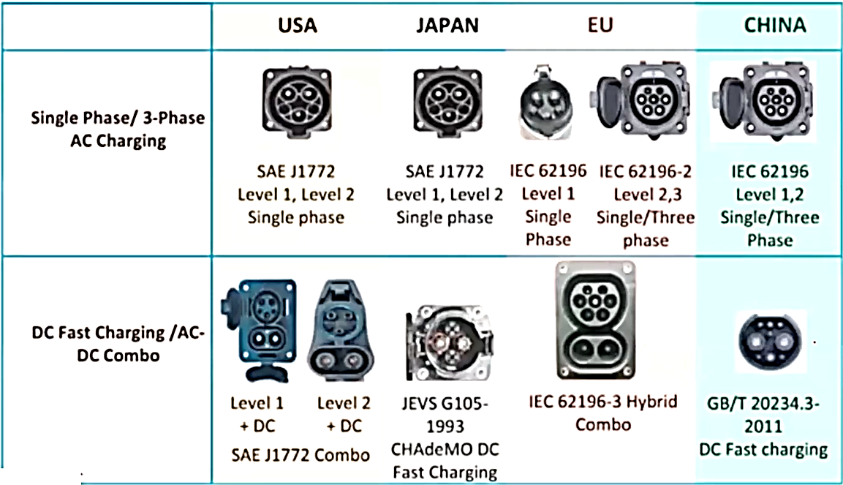

Slide 2
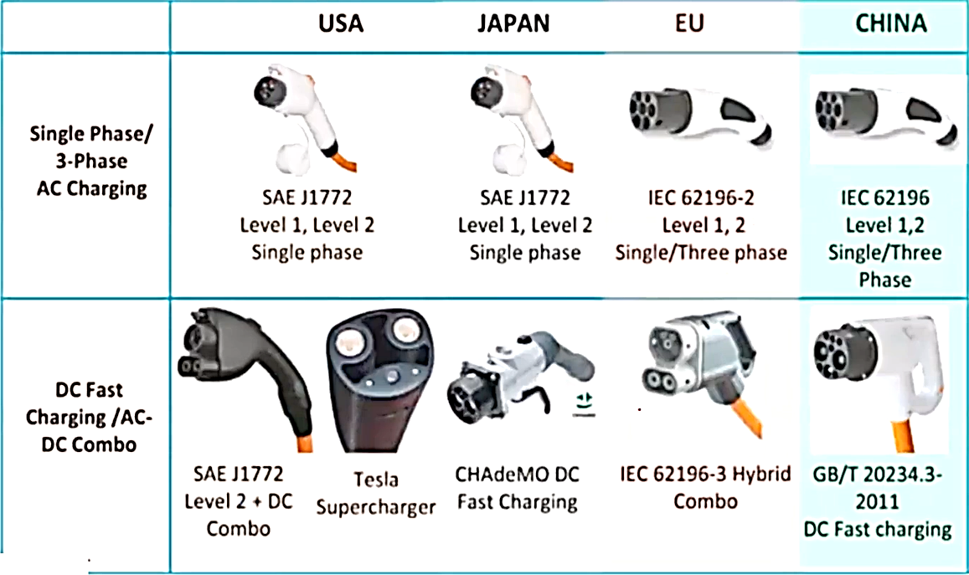

Slide 3
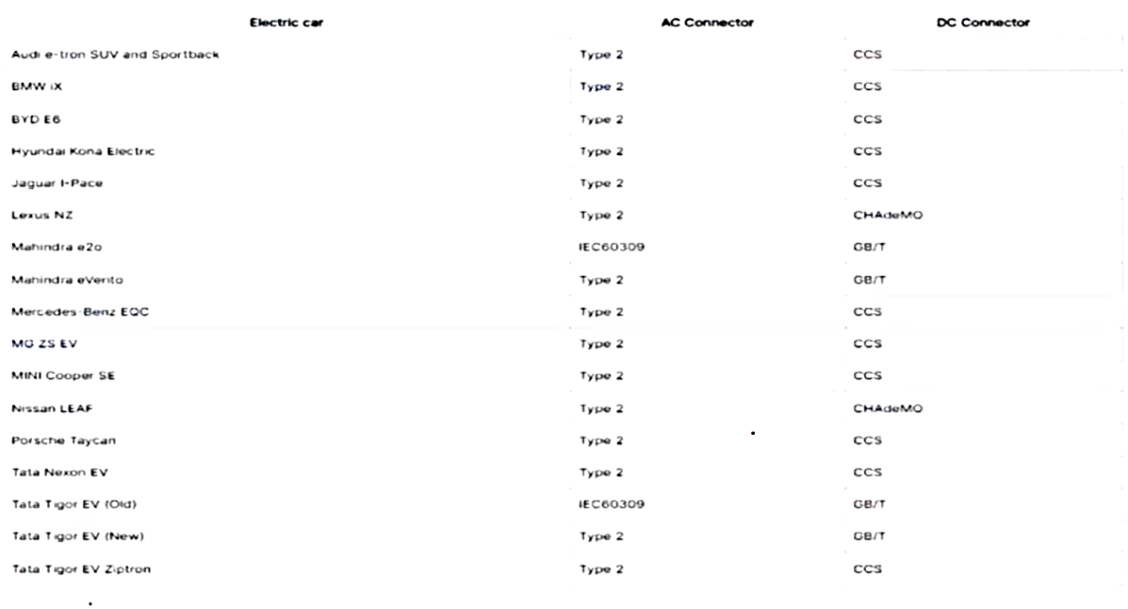
Indian Electric Cars & the Type of connectors:

Slide 4
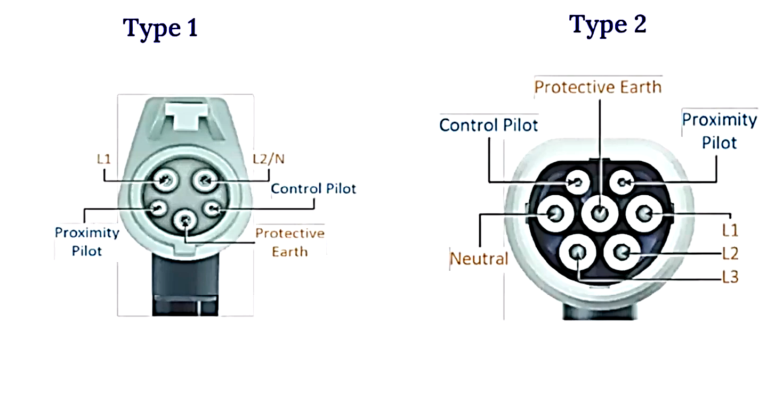

Slide 5
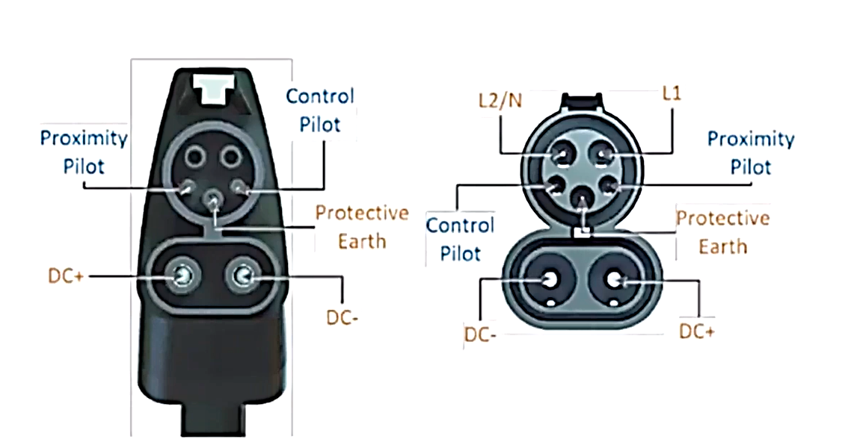
CCS / Combo 1

Slide 6
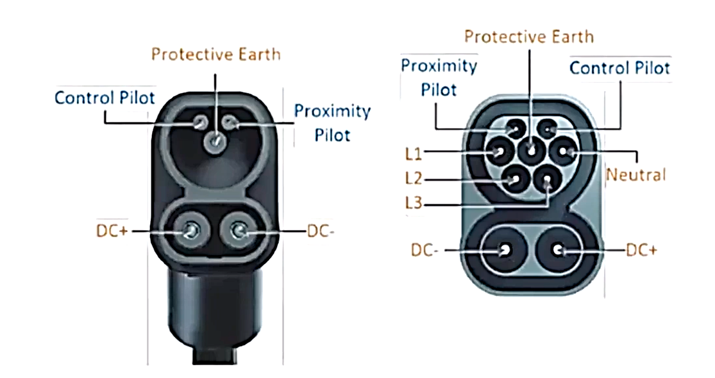
CCS / Combo 2

Slide 7
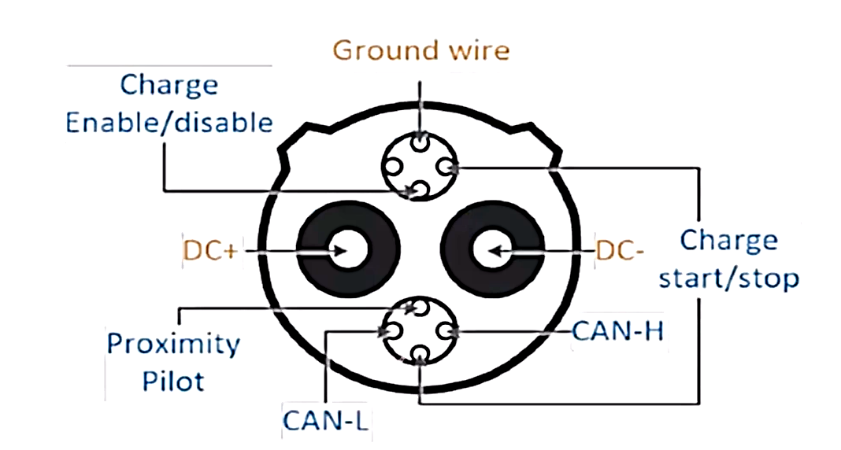
Chademo

Slide 8
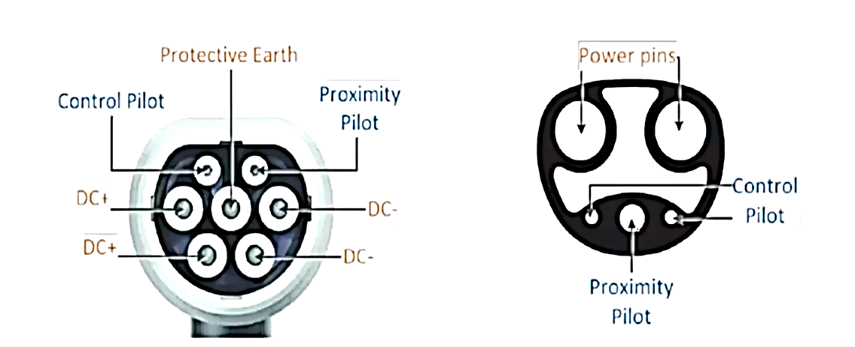
Tesla DC Chargers
DC Charging in Europe: Type 2 Connector
DC Charging in USA: Proprietary Connector

Slide 9
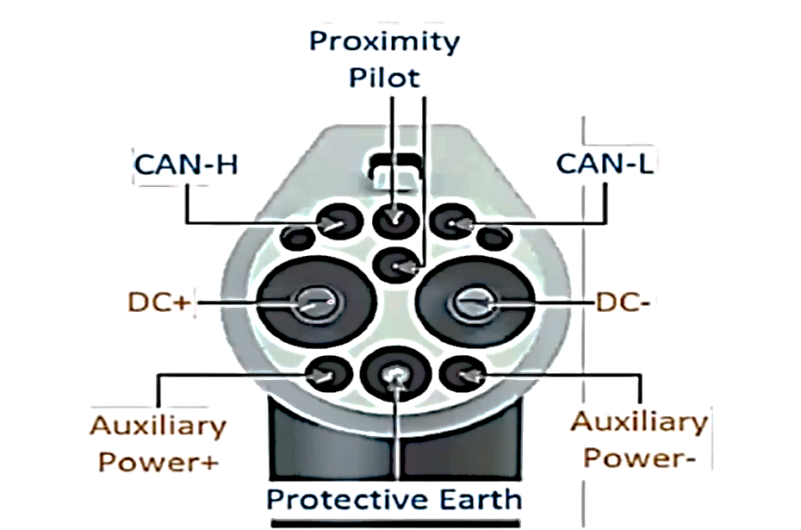
China GB/T

Slide 10
List of EV Charging Standards
IEC 62196-1/IEC 62196-2/IEC 62196-3
IEC61851-l/-21/-22/-23/-24
ISO/IEC 15118-1/-2/-3: ISO/IEC 15118
Chinese GB/T 20234.1/.2/.3
IS17017/lS17017-PART-1/IS17017-PART-2

